Slide 1
STOR 455 Review for Midterm 2

Slide 2

Extra Credit Group Prediction Competition
The Super Mario Bros. Movie (2023) will be released in theaters on April 5.
Task: Predict the accumulated box office (recorded or estimated by boxofficemojo.com) by May 5.
You may work in a group of at most 6 people.
Report your group forecast by 5pm April 19. Late submissions are not eligible for extra credits.
The 5 teams with the most accurate prediction will receive 1% of course grade for all team members.
The next 5 teams with the most accurate prediction will receive 0.5% for all team members.
Tiebreaker: In case of the same accuracy, the team that submits the project report earlier ranks higher.

Slide 3
Further details
RMD template file uploaded to Sakai.
Enter the very cool name of your group and team member information (name and PID).
Edit the file to enter your prediction (one number).
Enter a brief justification (2 or 3 sentences).
Email format: In all emails related to the project, start the title of your email with ``[STOR455 Project] Your group name}
Feel free to email me if you are looking for group members.
To earn more extra credits, base your group prediction on a data analysis.
Data: Either use some existing data or collect your own data.
Analysis: Build a good linear model for the response.
Provide a correct data collection and analysis to earn an additional1% extra credit (regardless whether your prediction is accurate or not).

Slide 4
Avoid Plagiarism!
There is existing literature of predicting movie box offices. You are encouraged to read and use them.
Avoid plagiarism from existing literature. Be sure to provide proper and accurate references and citations to any resource you use.
Avoid plagiarism from your classmates' project report. Work with your team but not with other groups.
Any project showing any sign of plagiarism will receive a grade of 0 and will be further investigated.

Slide 5
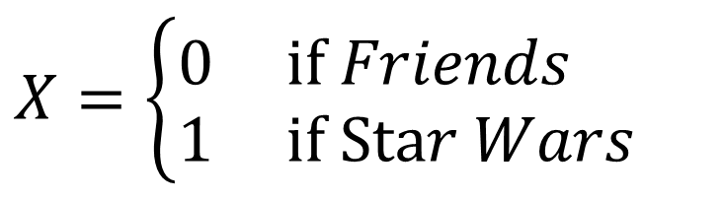
Coding “Dummy” Predictors
We can code a categorical predictor as (0,1)
How should this be interpreted in a regression?
Example: Y = Amazon Price
$$X=\left\{\begin{aligned}&0 \text{if} Friends \\ &1 \text{if} \text{Sta}r Wars\end{aligned}\right.$$

Slide 6
Comparing Two Regression Lines (with a multiple regression)
Example:
Y=Amazon Price
X₁= Pieces X₂= Theme(0,1)
Quantitative
Indicator
Interaction

Slide 7
Interpretation of Slopes
$$\hat{Amazon_Price}=\text{9.06395}+\text{0.11233}Pieces\text{−1.51114}Theme+\text{0.03532}Pieces∗Theme$$
For “Friends” lego sets,
$$\hat{Amazon_Price}=\text{9.06395}+\text{0.11233}Pieces$$
For “Star Wars” lego sets,
$$\hat{Amazon_Price}=\text{9.06395}+\text{0.11233}Pieces\text{−1.51114}+\text{0.03532}Pieces$$
= 7.5528+0.14765 $Pieces$
These lines match the ones we fitted separately in each group.

Slide 8
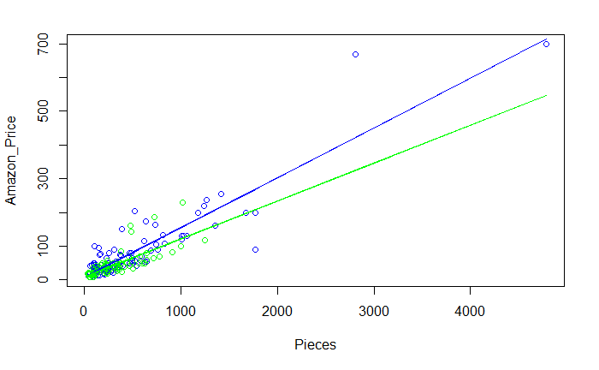
Are these lines “significantly” different?
Star Wars
Friends

Slide 9
Example 1
StateSAT2 <- read_csv("StateSAT2.csv")
modSAT1= lm(SAT ~ Takers +
Region +
Takers*Region,
data=StateSAT2
)
Suppose we regress “SAT” on “Takers” within each group of “Region,” what is the difference between the slope in the region “Midwest” and that of the region “Southeast”?

Slide 10
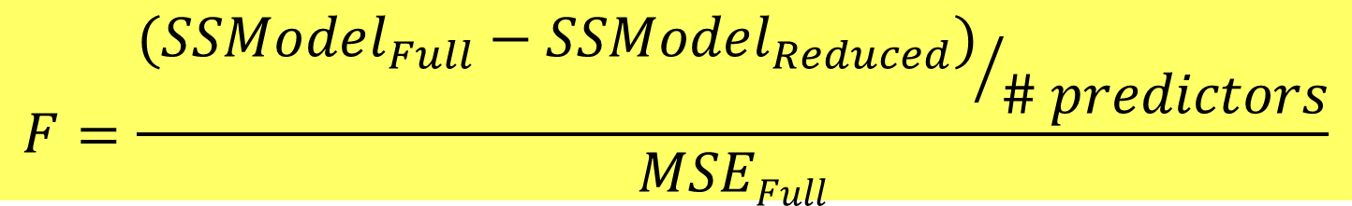
Nested F-test
Test: H_{o}: β_{i}=0 for a “subset” of predictors
H_{a}: β_{i}≠0 for some predictors in the subset
Explained by full model
Explained by reduced model
$$F=\frac{{(SSModel_{Full}−SSModel_{Reduced})}/{\# predictors}}{MSEFull}$$
#predictors tested in H₀
Based on full model
Compare to F-distribution

Slide 11
Polynomial Regression
For a single predictor X:
(linear)
(quadratic)
(cubic)

Slide 12
Example 2
modSATquad2_byregion = lm(SAT ~
Takers +
I(Takers^2) +
Region +
Takers*Region +
I(Takers^2)*Region,
data=StateSAT2
)
Provide a 95% prediction interval of the SAT score for a state in southeast with 80% Takers

Slide 13
Leverage in Multiple Regression
For a multiple regression with k predictors:
Look for:
or

Slide 14
Cook’s Distance
How much would the fit change if one data value were omitted?
D_{i} increases with either poor fit (std.res_{i}) and high leverage (h_{i}).
Compare to other D_{i}’s.
Study any case with D_{i} > 0.5; worry if D_{i} > 1.0.

Slide 15
Binary Logistic Regression Model
Y = Binary response
X = Quantitative predictor
π = proportion of 1’s (yes, success,…) at any x
Probability form
Logit form
Linear Model

Slide 16

Odds
If π = proportion of “yes” (success, 1, ….)
the odds of yes are(is)
$$\frac{P(yes)}{P(no)}=\frac{π}{1−π}$$
With a little bit of algebra…
There is a one-one monotone correspondence between odds and π.

Slide 17
Example 3
If the odds are 2. What is the chance of winning?

Slide 18
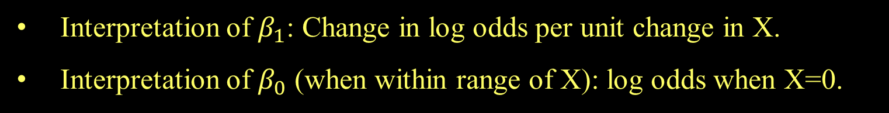
Odds and Logistic Regression
Logit form:
⇒
The logistic model assumes a linear relationship between the predictor and log(odds).
Interpretation of $β_{1}$: Change in log odds per unit change in X.
Interpretation of $β_{0}$ (when within range of X): log odds when X=0.

